Slide 1
Lecture 1
The concept and content of relations in the field of nuclear energy use. Goals and objectives of the course "Legal regulation of the use of nuclear energy"

Slide 2
Plan of the lecture:
The concept of nuclear energy
Pros and cons of nuclear energy
Goals and objectives of the course "Legal regulation of the use of nuclear energy"

Slide 3
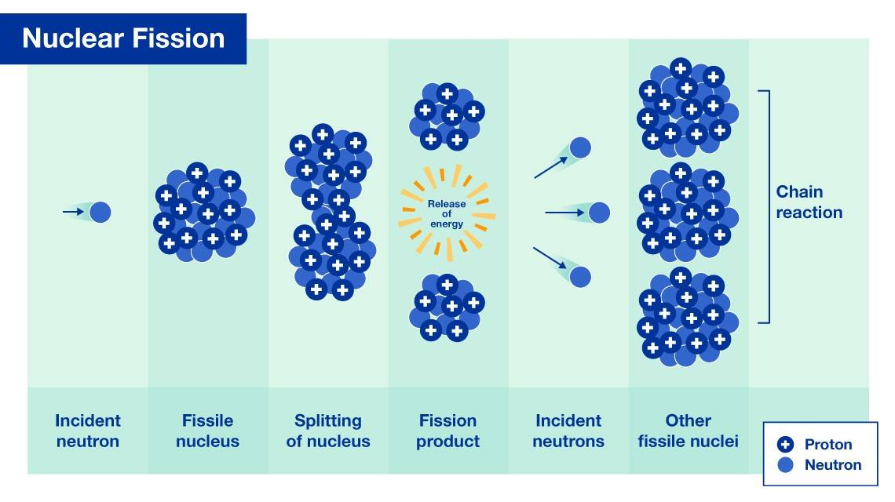

Slide 4
The concept of Nuclear energy
Nuclear energy is a form of energy released from the nucleus, the core of atoms, made up of protons and neutrons. This source of energy can be produced in two ways: fission – when nuclei of atoms split into several parts – or fusion (synthesis) – when nuclei fuse together. Typically, to obtain nuclear energy, a nuclear chain reaction of fission of plutonium-239 or uranium-235 nuclei is used.
Nuclear energy used worldwide today to generate electricity is generated through nuclear fission, while fusion-based electricity generation technology is still in the research and experimental development stage
Nuclear energy (atomic energy) is a branch of energy sector dealing with the production of electrical and thermal energy by converting nuclear energy. The first commercial nuclear power stations started operation in the 1950s.
Over 50 countries utilize nuclear energy in about 220 research reactors. In addition to research, these reactors are used for the production of medical and industrial isotopes

Slide 5
Advantages of Nuclear energy
1. Nuclear is a zero-emission clean energy source (air quality= no acid rain, smog, lung cancer ect.)
According to the Nuclear Energy Institute (NEI), the USA avoided more than 471 million metric tons of carbon dioxide emissions in 2020. That’s the equivalent of removing 100 million cars from the road
2. Despite producing massive amounts of carbon-free power, nuclear energy produces more electricity on less land than any other clean-air source.
A typical 1,000-megawatt nuclear facility in the US needs a little more than 1 square mile to operate. NEI says wind farms require 360 times more land area to produce the same amount of electricity and solar plants require 75 times more space.

Slide 6
Advantages of Nuclear energy
3. Nuclear energy produces minimal waste
All of the used nuclear fuel produced by the U.S. nuclear energy industry over the last 60 years could fit on a football field at a depth of less than 10 yards!
That waste can also be reprocessed and recycled, some advanced reactor designs being developed could operate on used fuel.
4. Partly Environmentally friendly energy
5. Nuclear power plants are cheaper to operate than their coal or gas competitors. It has been estimated that even with costs such as radioactive fuel management and nuclear disposal
6.It's safe and reliable – providing us with power whatever the weather (wind, solar)

Slide 7
Disadvantages of Nuclear Energy
1. Expensive Initial Cost to Build.
Construction of a new nuclear plant can take anywhere from 5-10 years to build, costing billions of dollars.
2. Risk of Accident
Chernobyl, Three Mile Island, Fukushima Daiichi are disasters that nobody wants to experience ever again under any circumstances
3. Radioactive Waste
Even though nuclear energy production doesn’t emit any emissions, it does produce radioactive waste that must be securely stored so it doesn’t pollute the environment. Although in small quantities, radiation isn’t harmful, the radioactive waste from nuclear energy production is quite dangerous.
4. Limited Fuel Supply
Nuclear energy is not a renewable energy source
5. Impact on the Environment
In addition to the waste that they produce, nuclear power plants create other impacts to the environment. For example, the mining and enrichment of uranium are not environmentally friendly processes (land and water pollution)

Slide 8
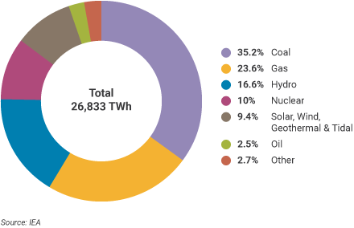
Nuclear Power in the World Today

Slide 9
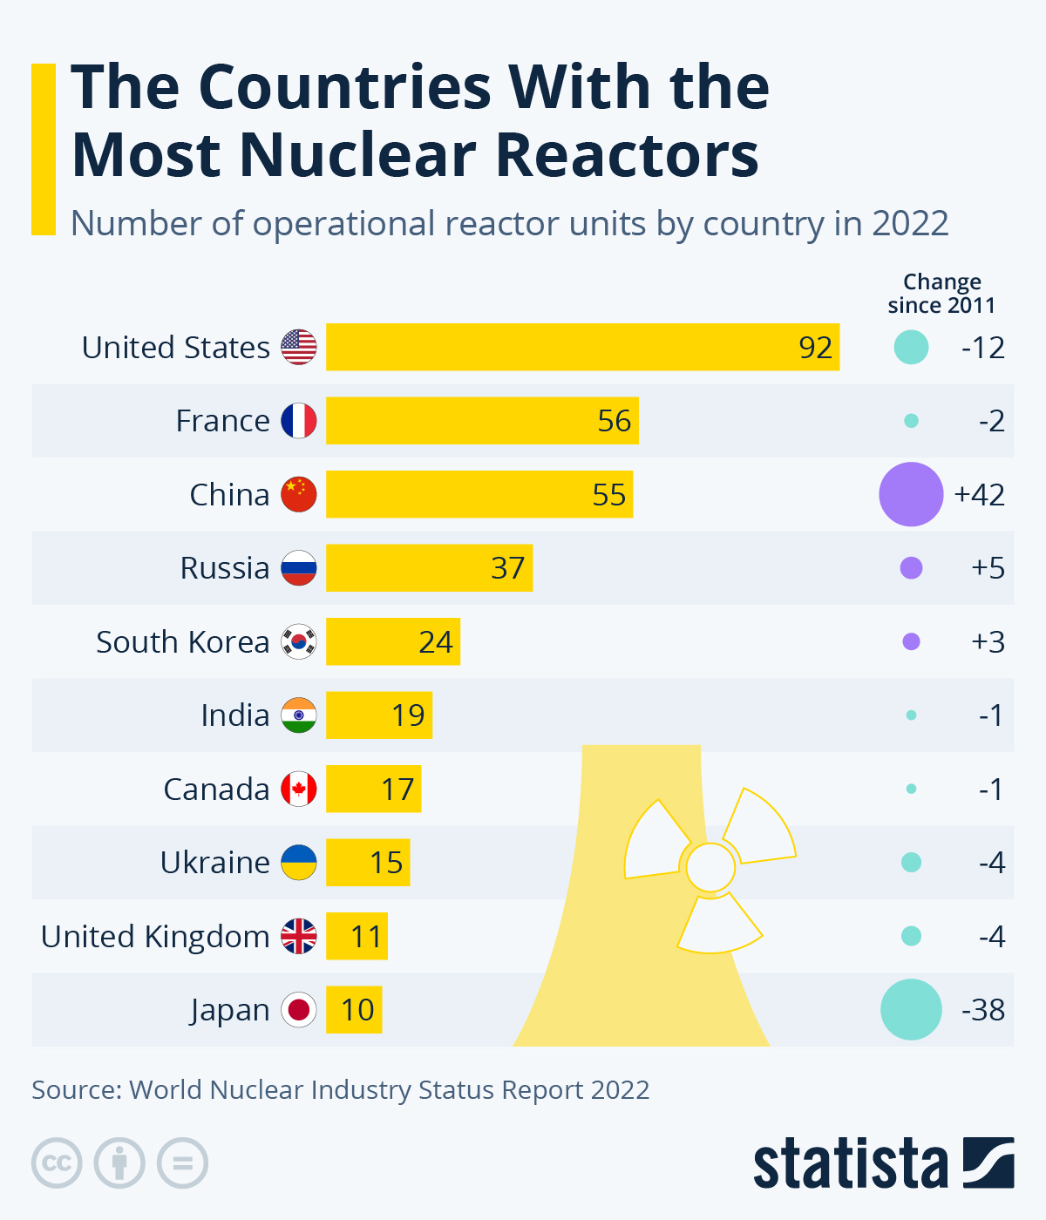

Slide 10
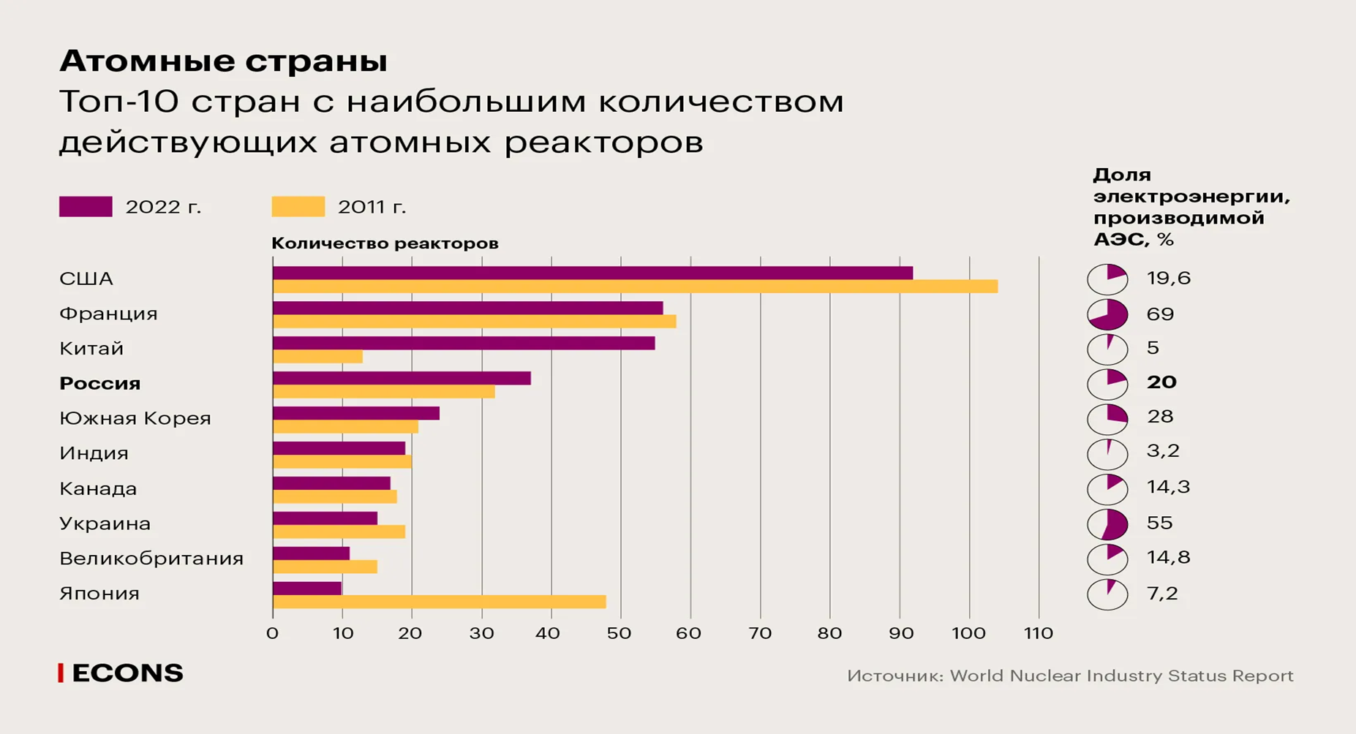

Slide 11
System of Energy Law
Special part
General parts
includes studying of the following issues:
Legal regulation of gas sector
Legal regulation of oil sector
Legal regulation of coal industry
Legal regulation of heat supply
Legal regulation of electric power industry
Legal regulation of nuclear energy
Renewable source of energy
includes studying of the following issues:
The concepts, principles, sources of Energy Law
state regulation in the field of energy sector
self-regulation in the field of energy sector
contractual regulation in the field of energy sector

Slide 12
Subject of legal regulation of nuclear energy
Nuclear energy (atomic energy) is a branch of energy dealing with the production of electrical and thermal energy by converting nuclear energy. So, the subject is all public-legal (vertical) and private legal (horizontal) relations in the field of nuclear energy

Slide 13
The goals and objectives of the course
The purpose of the course is to study nuclear energy issues from a legal point of view, to show the regulation of this issue both in national legislation and international law.
At the same time, we will consider the study of nuclear energy for peaceful purposes, as energy, but will not study the issues of using nuclear energy as a weapon and ensuring nuclear safety (which is part of international public law).
Therefore, international conventions will be affected in terms of the use of nuclear energy, ensuring radiation safety, and radioactive waste management.
For details see syllabus

Slide 14
Additional information
https://www.gov.kz/memleket/entities/energo/activities/214?lang=en
Decree of the Government of the Republic of Kazakhstan dated June 28, 2014 No. 724. “On approval of the Concept for the development of the fuel and energy complex of the Republic of Kazakhstan for 2023 – 2029”

Slide 15
Task for seminars 1, 2
1. Definition , pro and cos of nuclear energy
2. Programs for the development of the nuclear industry the Republic of Azerbaijan (presentation)
3. Search for scientific articles on the use of nuclear energy in the world/ Azerbaijan. Make a list, indicate the sources (link). To prepare a summary of one article you like.

